Slide 1
State Medical Board of Ohio Updates
Bruce Saferin, DPM – Medical Board Supervising Member
November 19, 2022

Slide 2
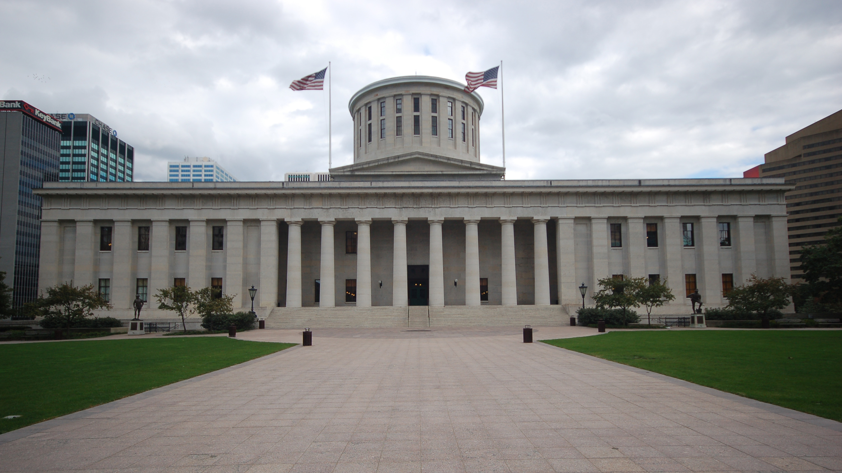
Statutes
Laws enacted by Ohio legislature
Ohio Revised Code (ORC)
Rules
Regulations developed and enacted by Medical Board
Ohio Administrative Code (OAC)
Rules clarify & amplify provisions in the Ohio Revised Code
Notes:
Ohio law is the current set of statutes decided upon by the Ohio General Assembly, comprised of the Ohio House of Representatives and Ohio Senate and signed by the governor. They are collected and published in the Ohio Revised Code (ORC).
Rules are adopted by the state agencies of Ohio and are established to carry out the policies and intent of the law. They are collected and published in the Ohio Administrative Code (OAC).

Slide 3
The Board
The Medical Board is the state agency charged with regulating the practice of medicine and other selected health professions.
12 members appointed by the governor to 5-year terms:
9 doctors: 7 MDs, 1 DO, and 1 DPM
3 consumer members
The board meets the second Wednesday of each month in the Rhodes Tower and livestreams the meetings on its YouTube channel.
Notes:
The Medical Board was created in 1896 and originally licensed allopathic physicians and midwives.
The amount off physicians and consumer board members allowed to serve on the board is mandated by state law in ORC 4731.01.

Slide 4
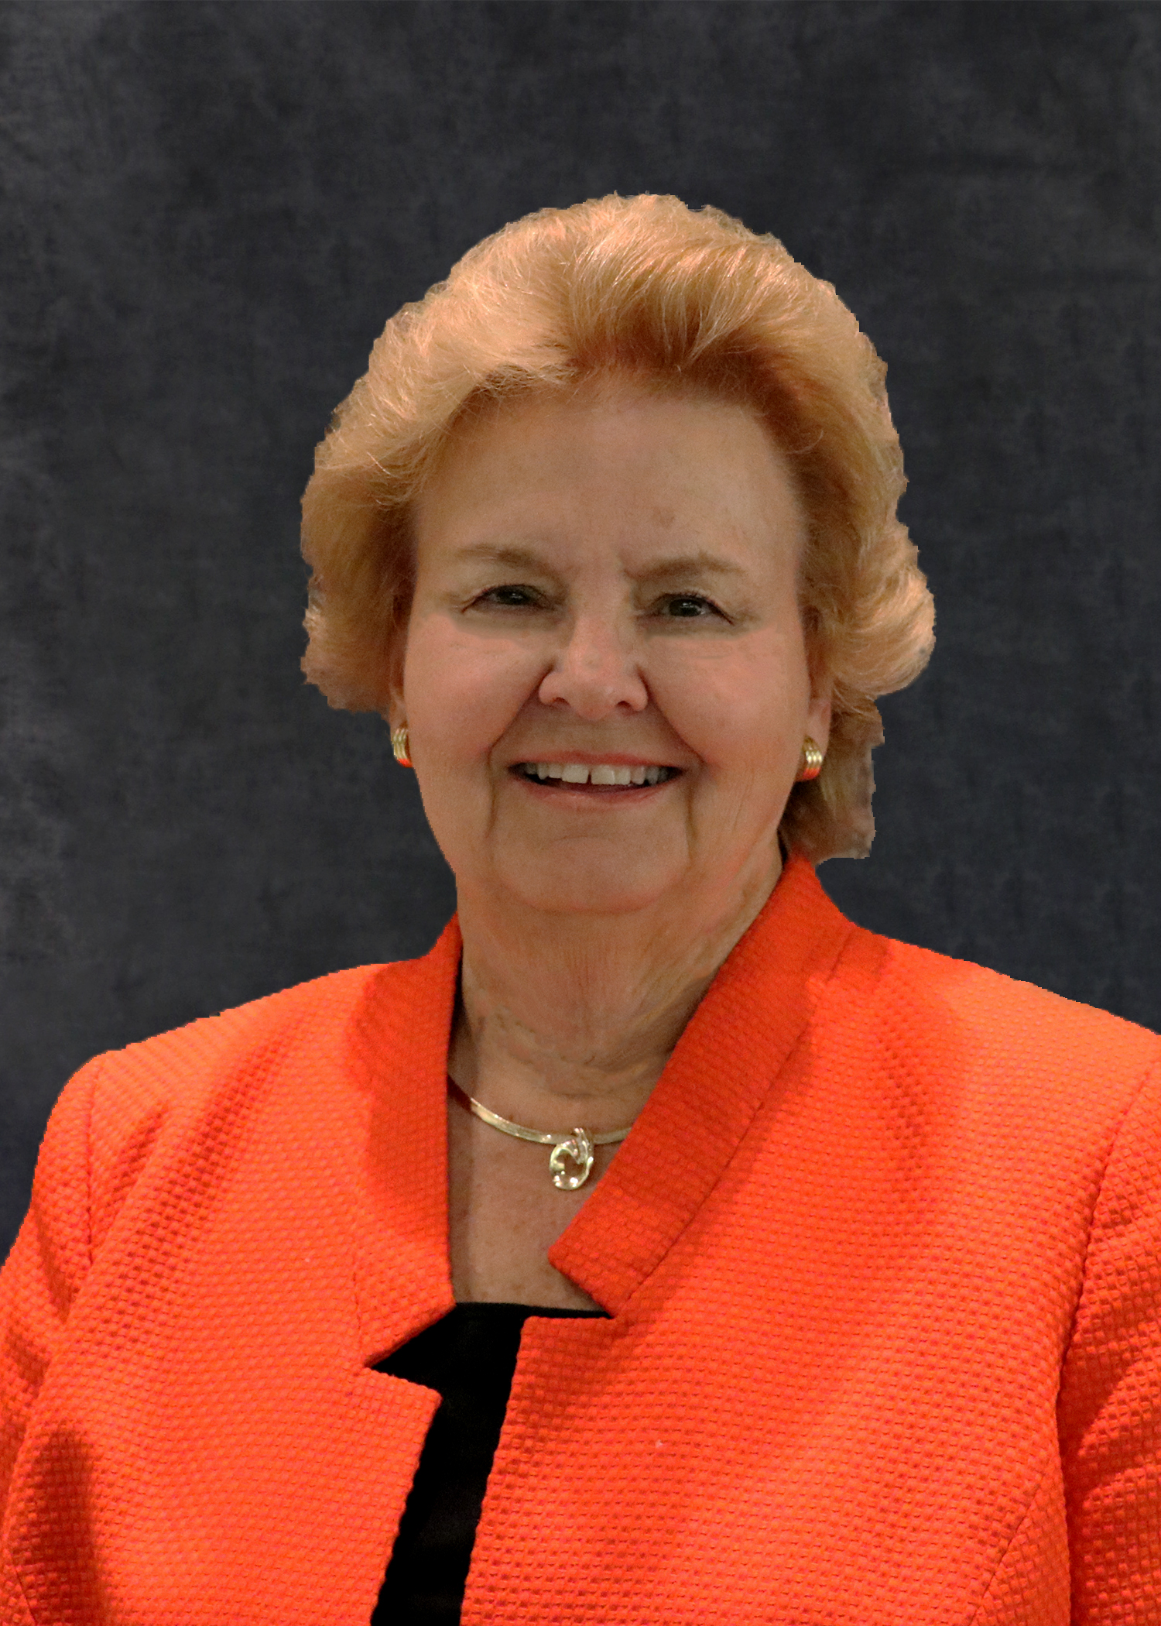
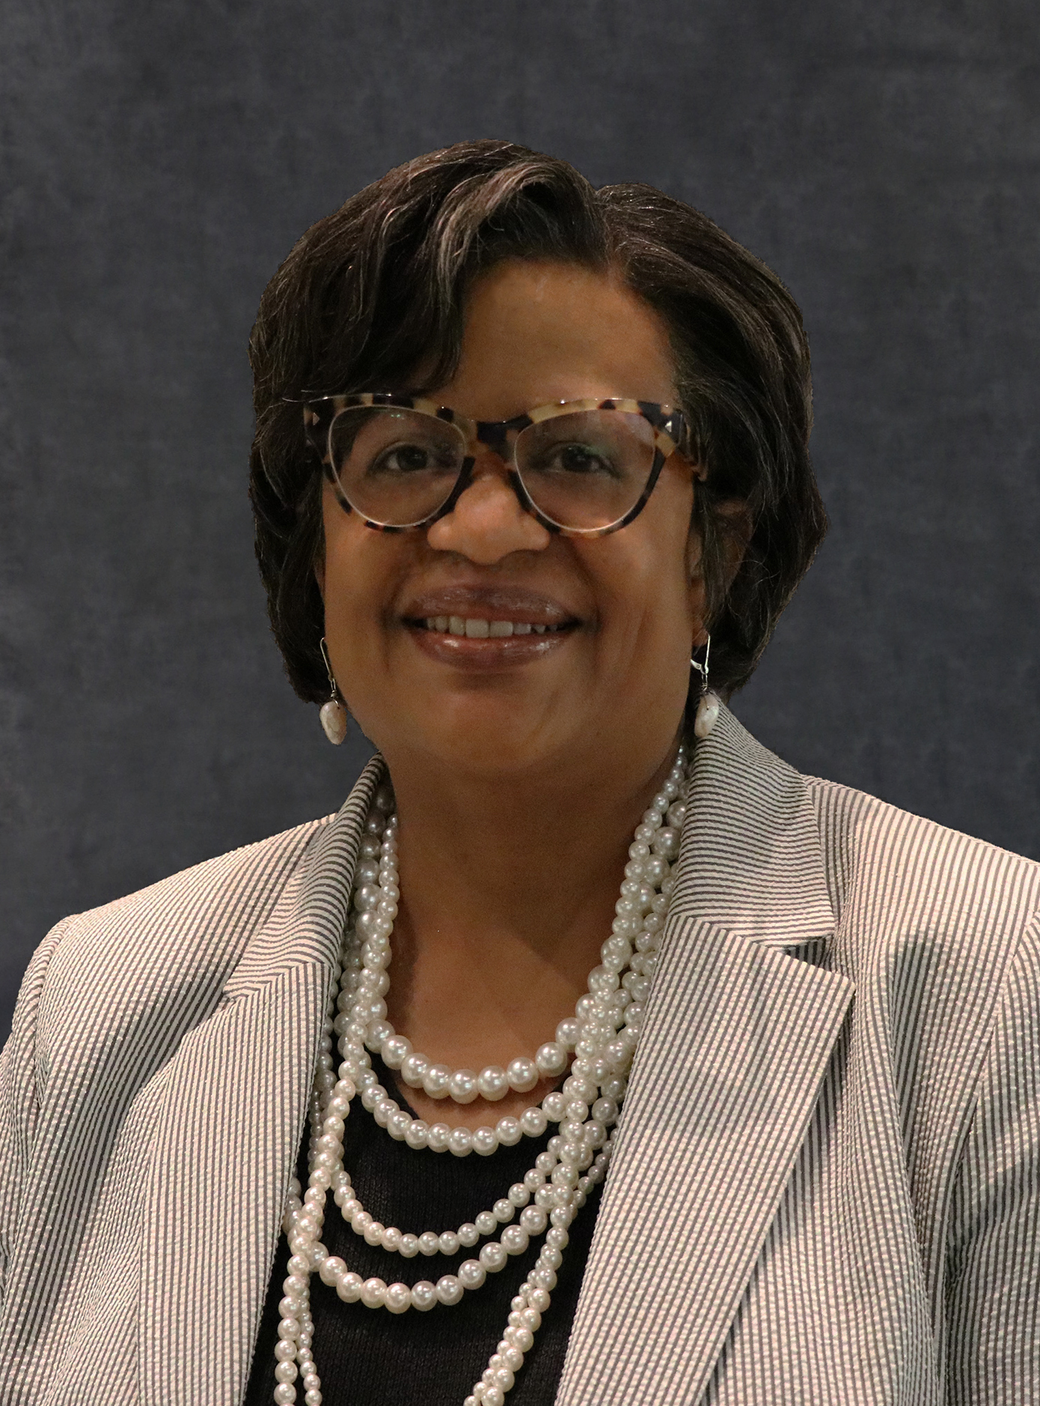
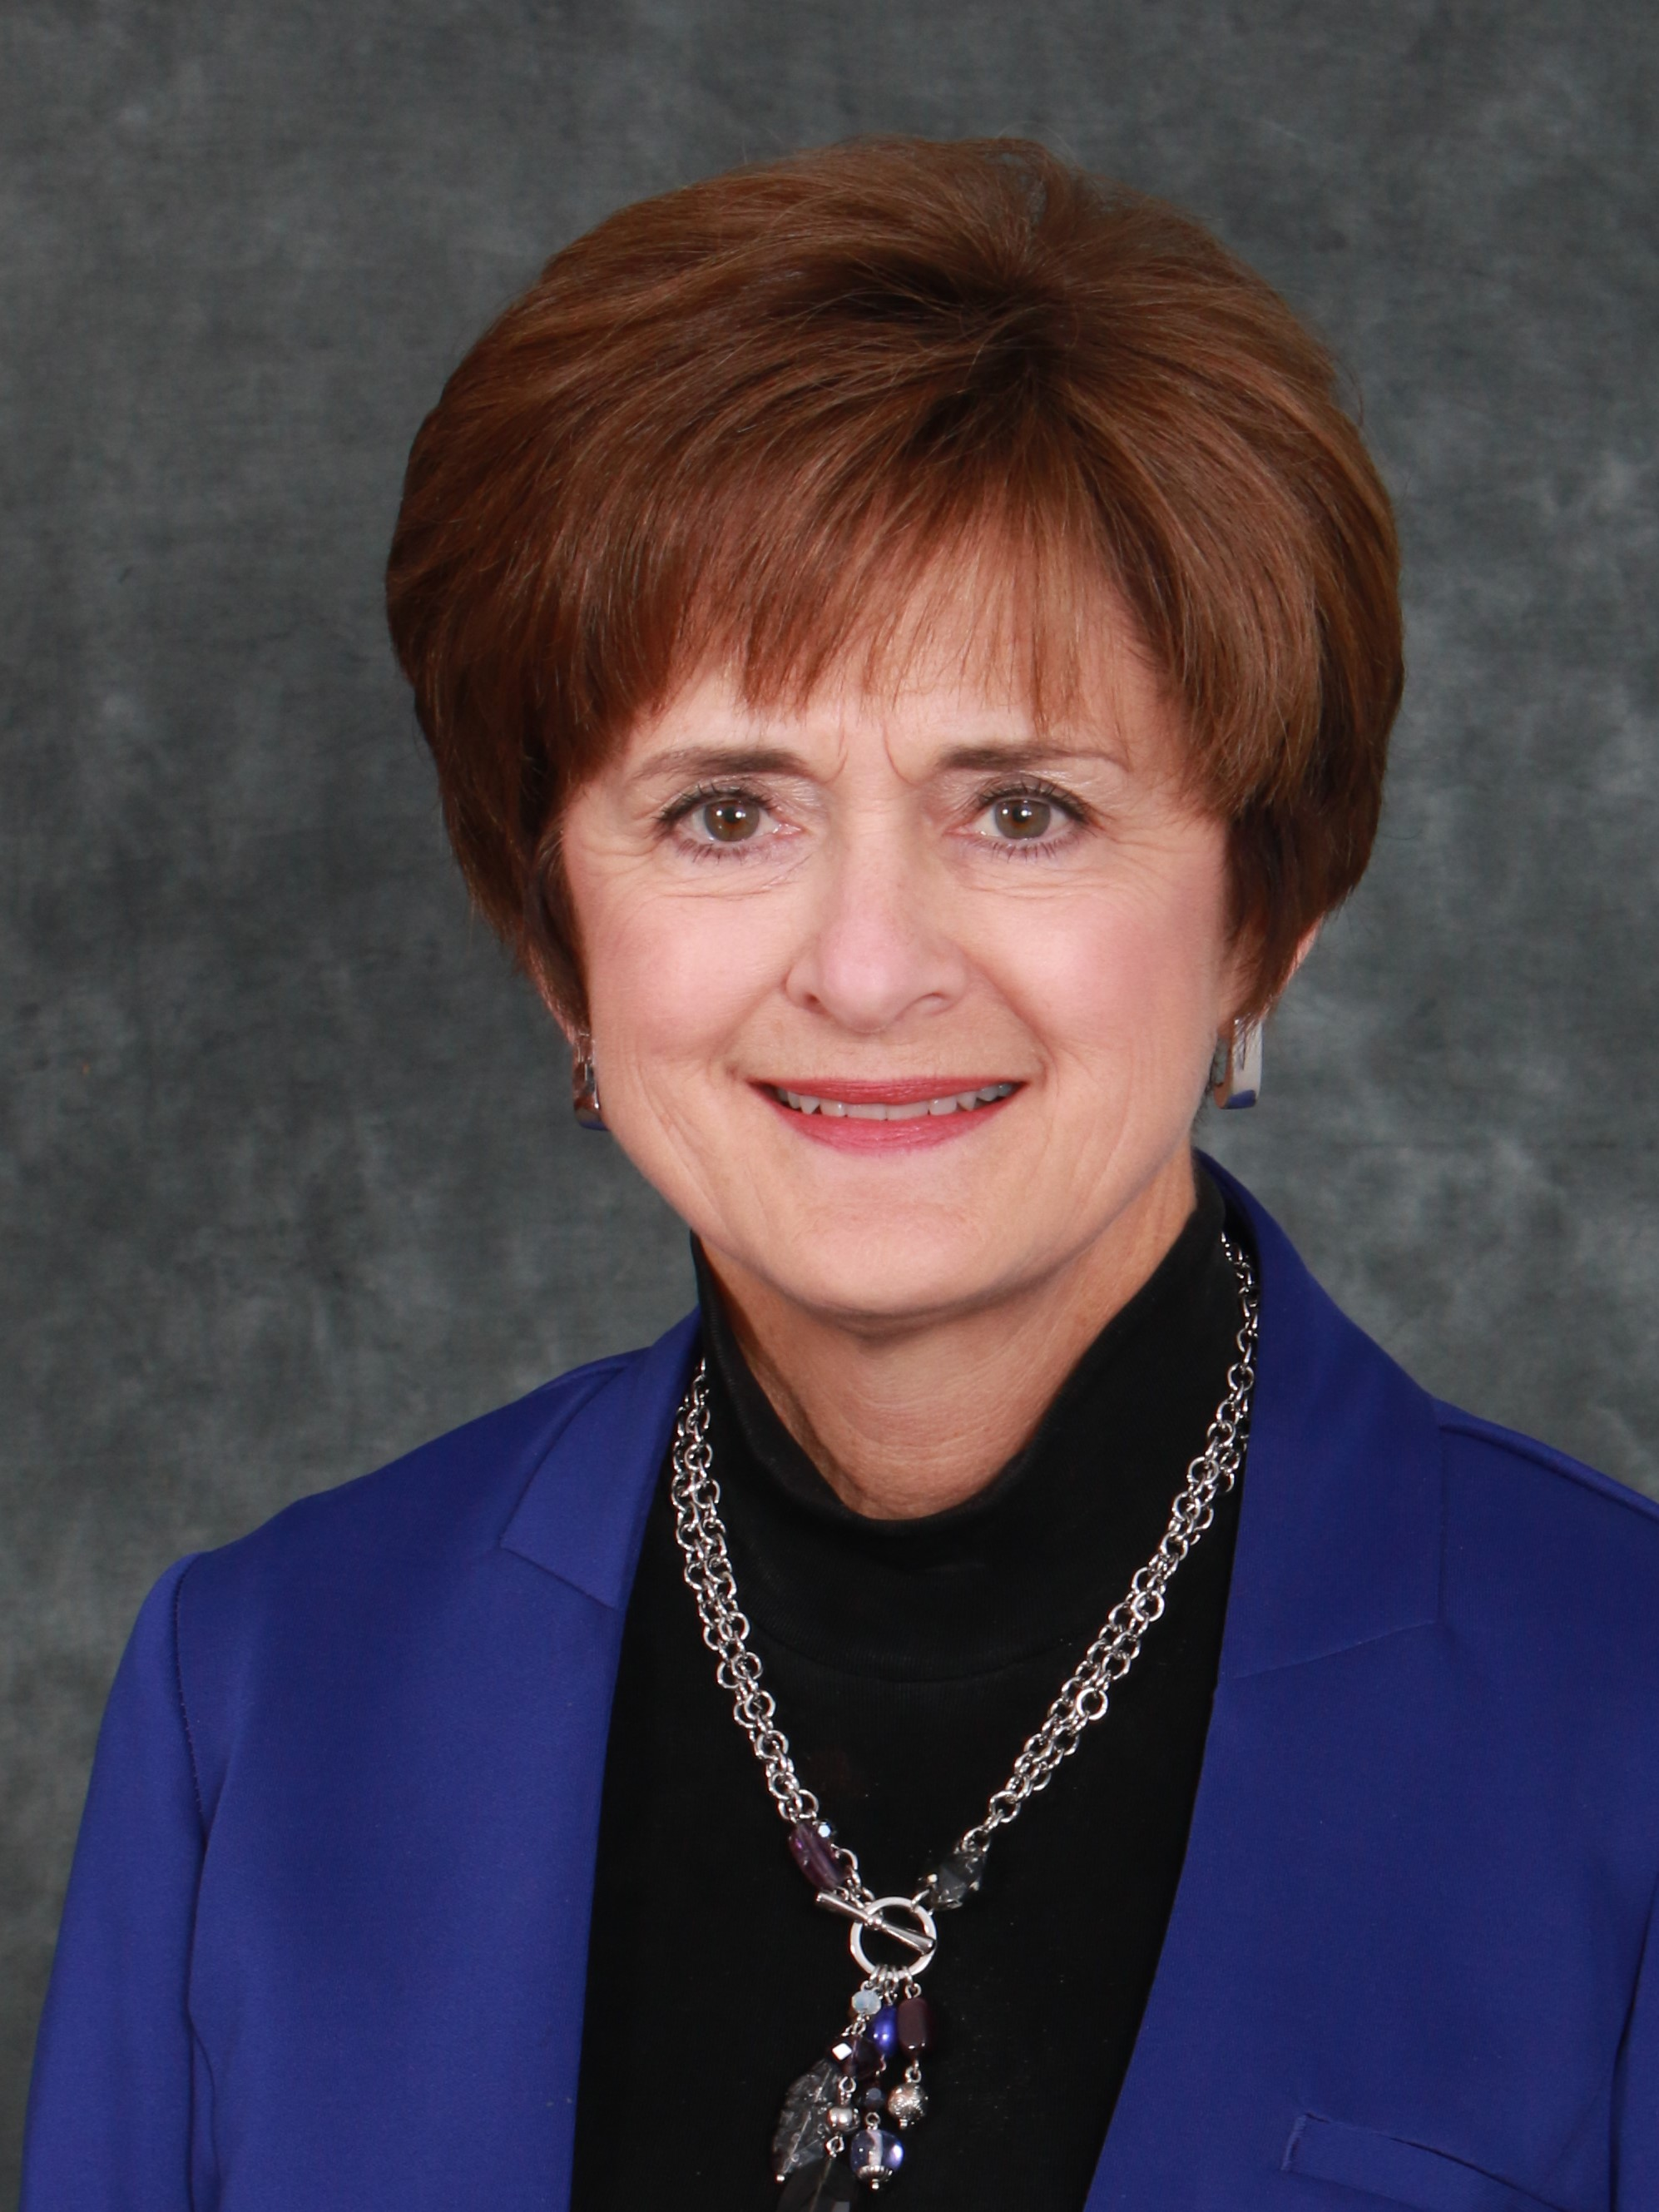
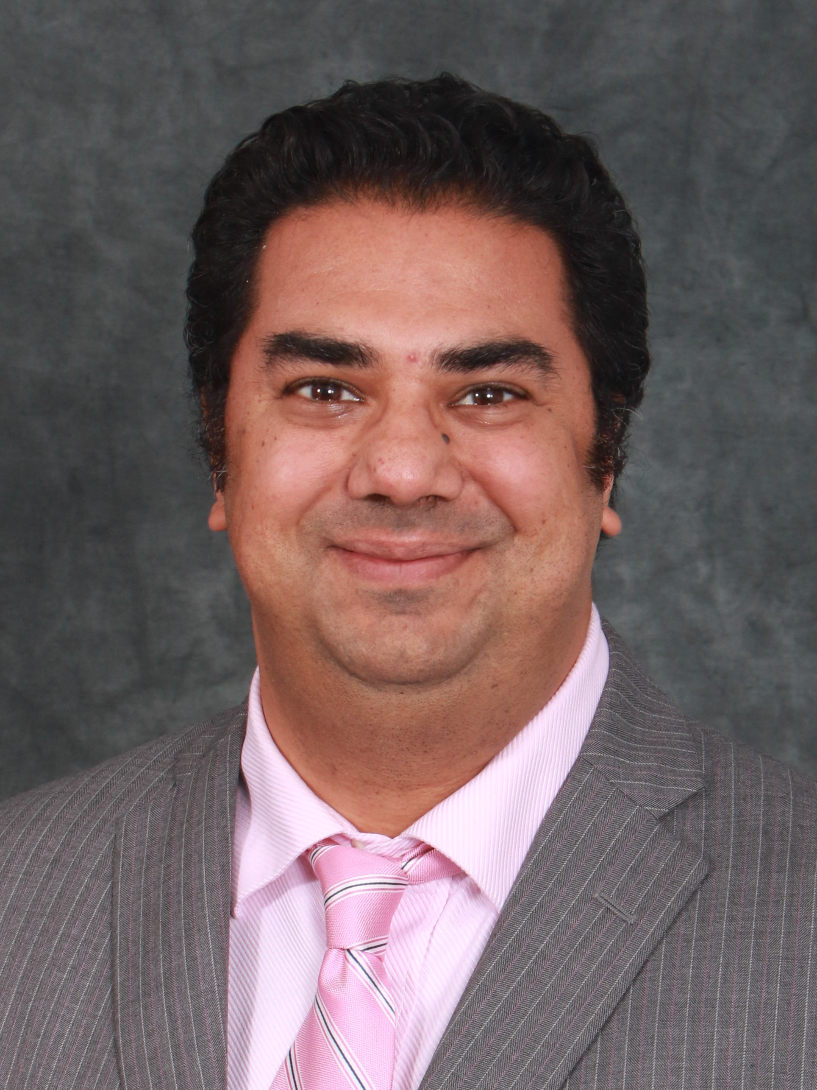
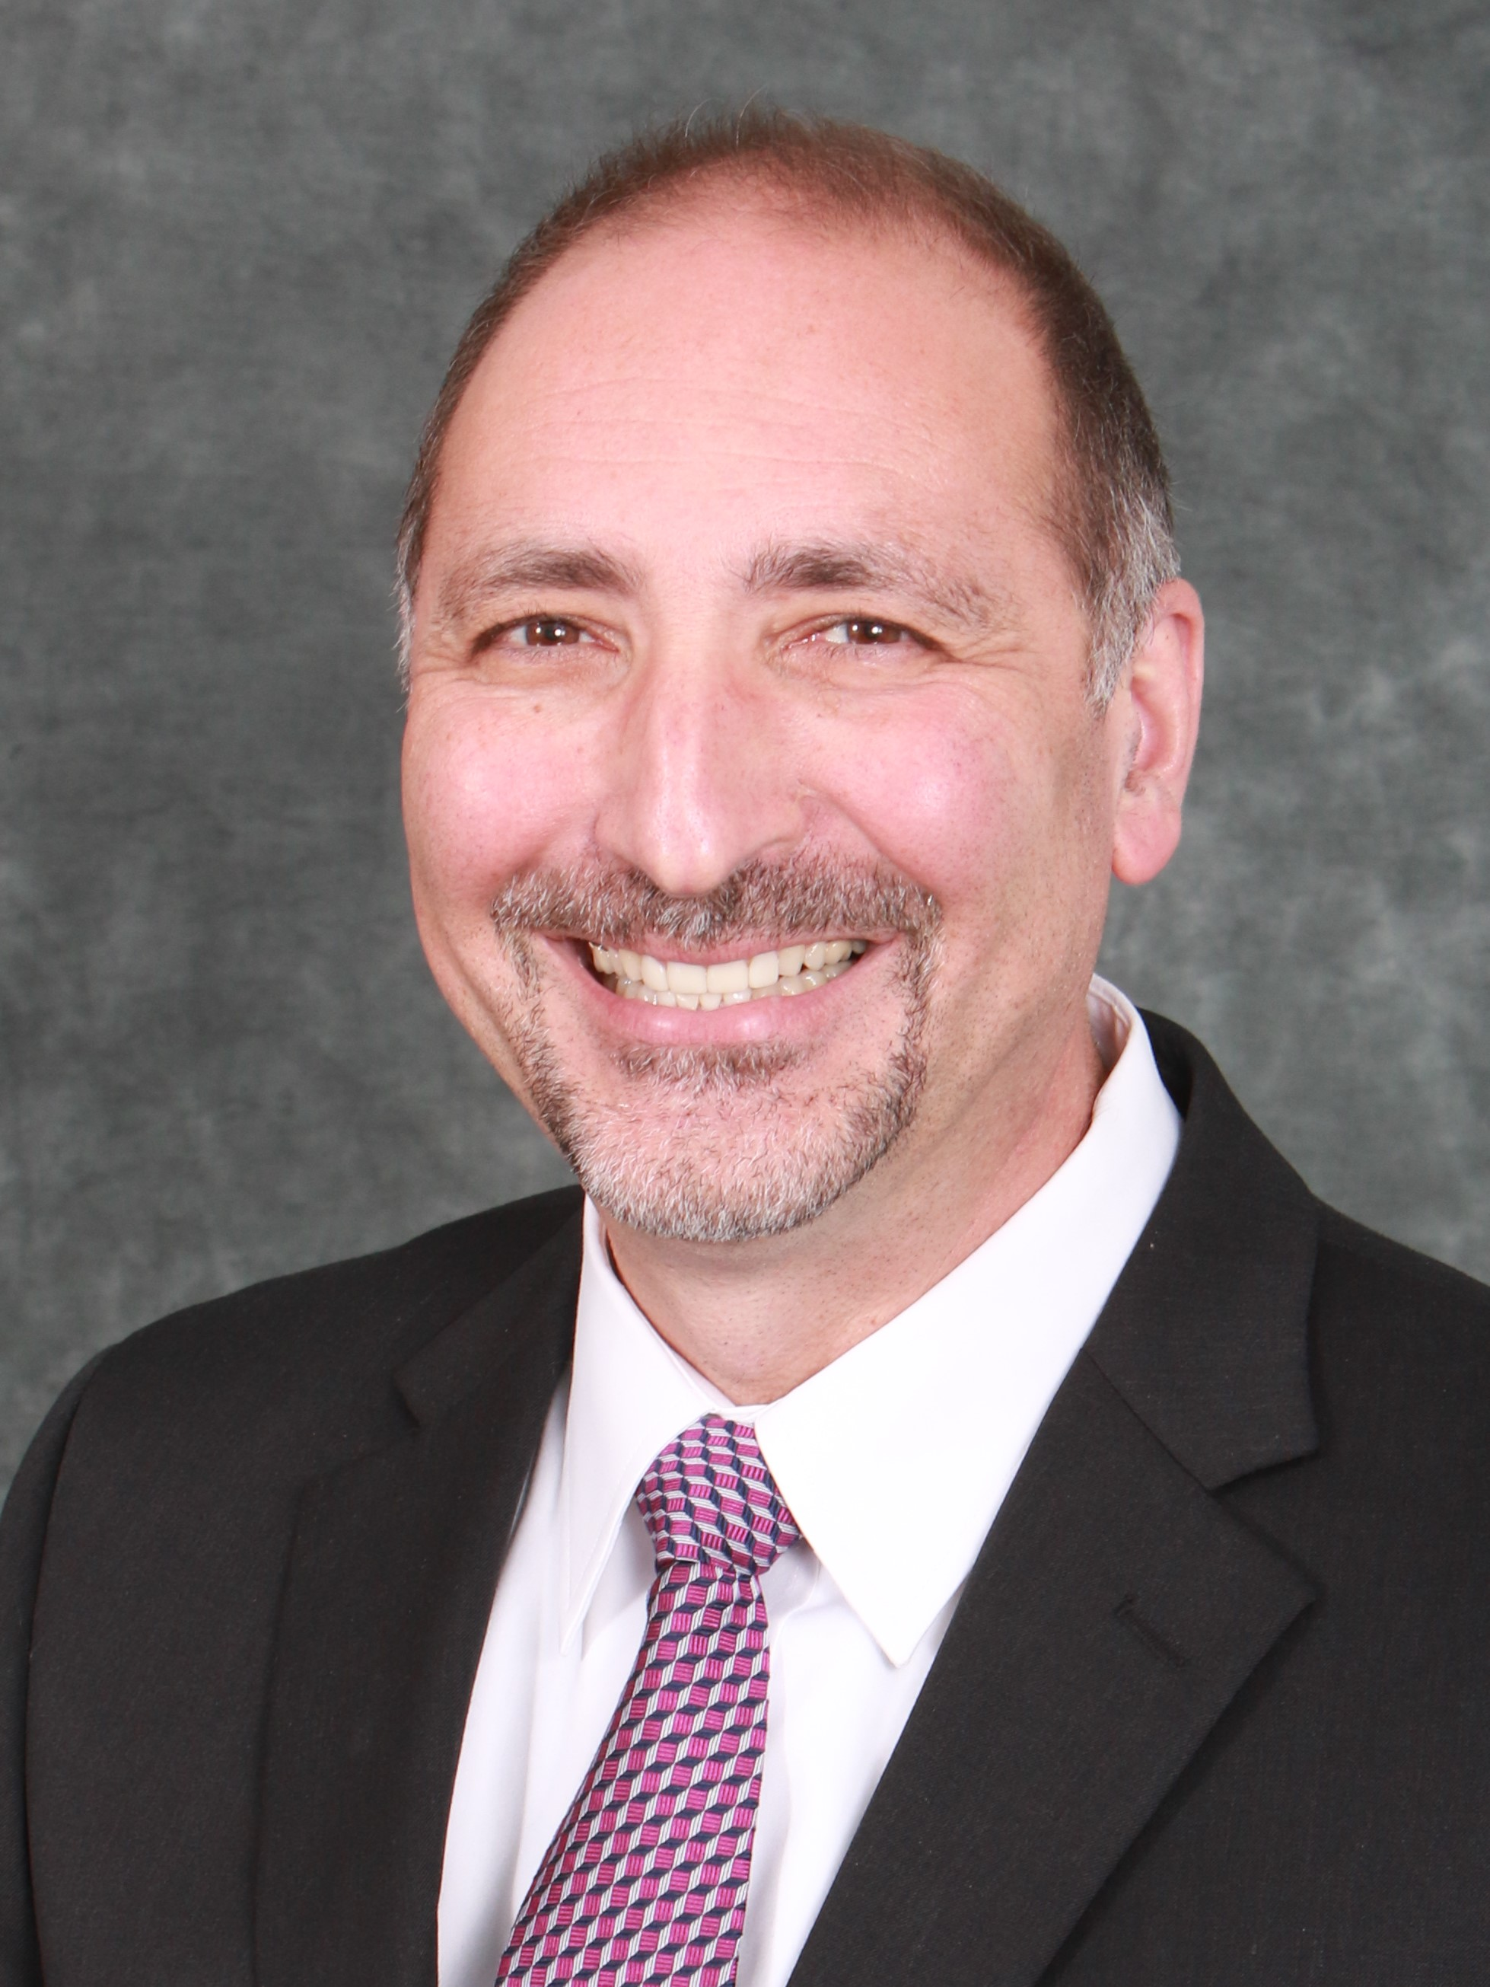
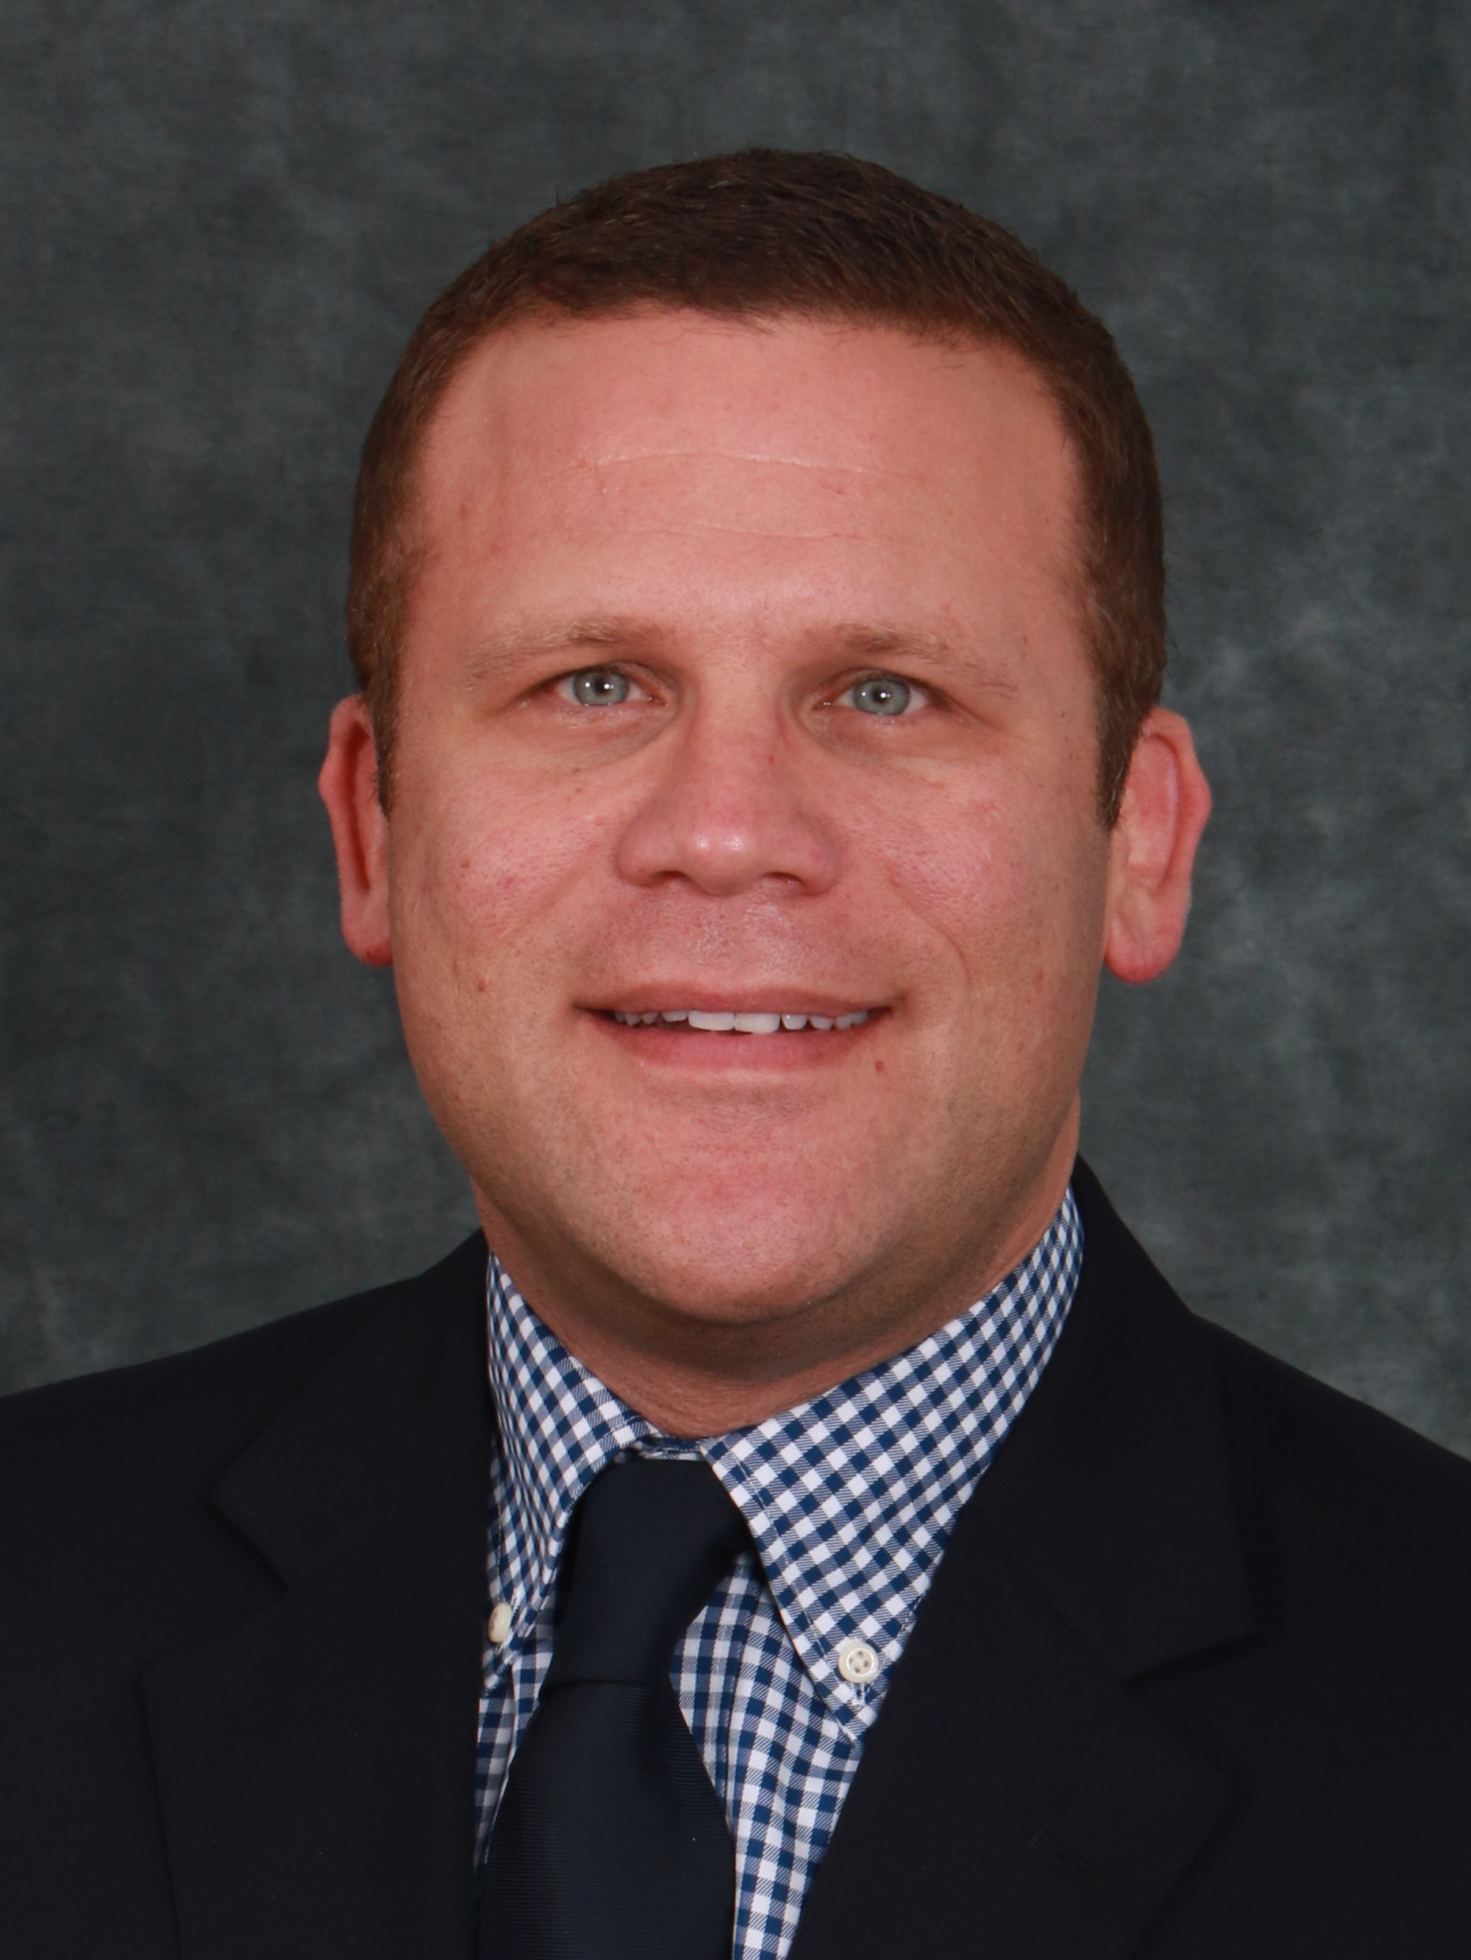
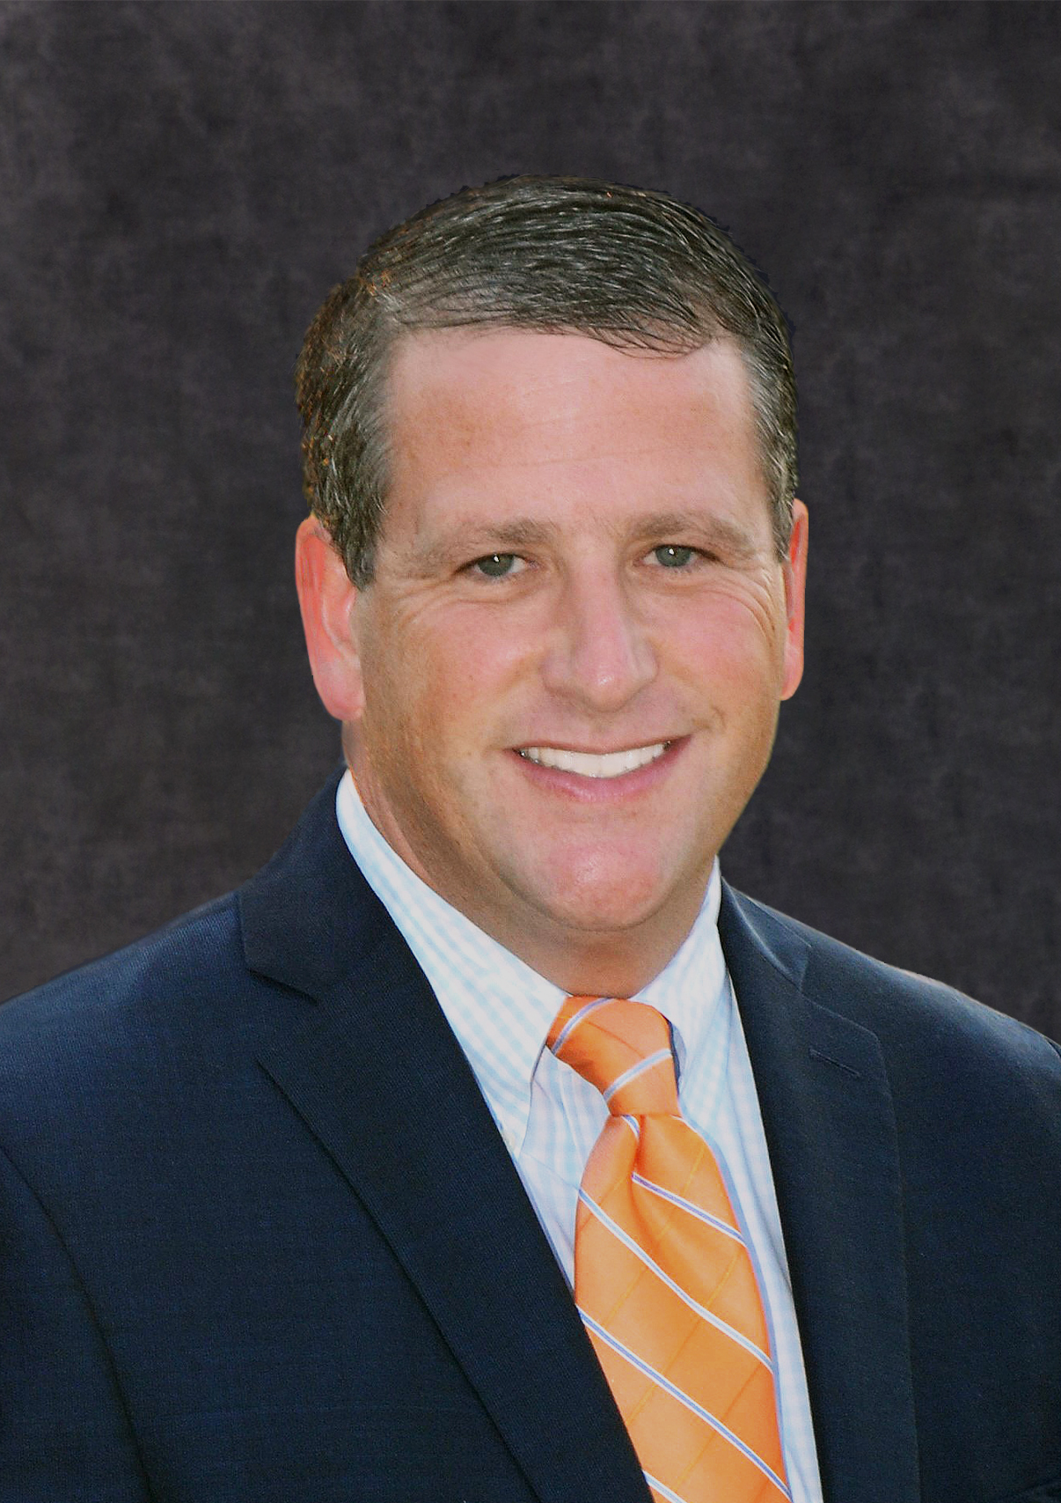
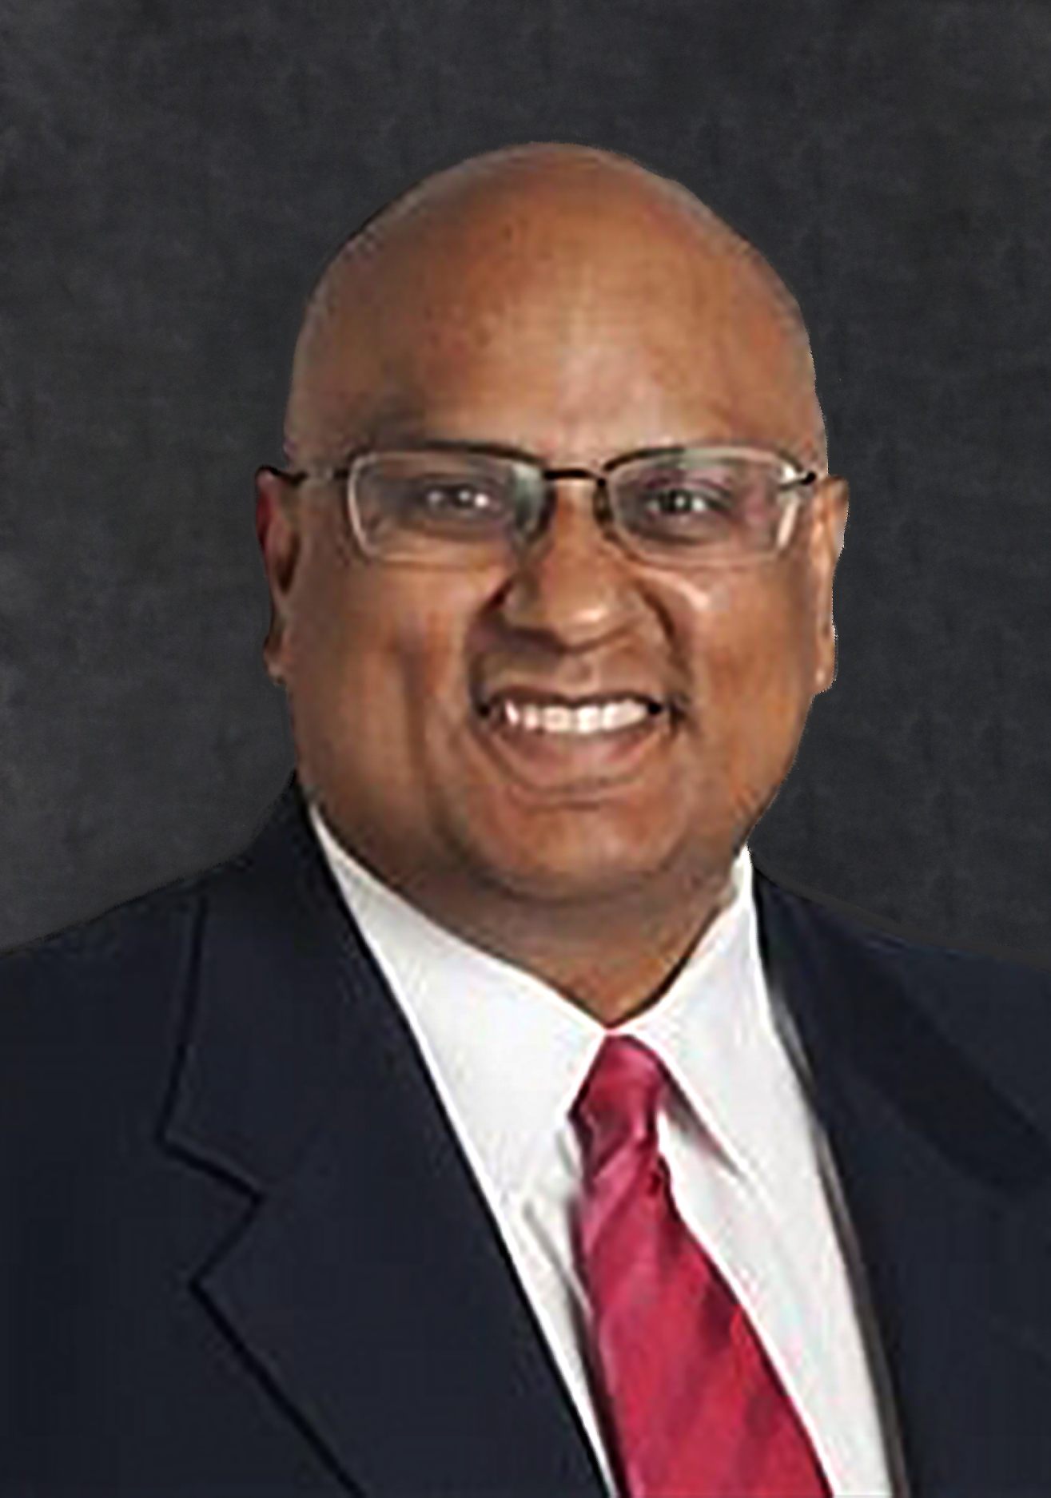
Medical Board Members
Betty Montgomery, JD
President
Sherry Johnson, DO
Vice President
Kim Rothermel, MD
Secretary
Bruce Saferin, DPM
Supervising Member
Amol Soin, MD, MBA
Robert Giacalone, RPh, JD
Michael Gonidakis, JD
Michael Schottenstein, MD
Jonathan Feibel, MD
Harish Kakarala, MD
Yeshwant Reddy, MD
Mark Bechtel, MD

Slide 5
License Types
The Medical Board regulates more than 95,000 licensees.
Allopathic Physicians 45,186 | Anesthesiologist Assistants 356 | Massage Therapists 11,428
Osteopathic Physicians 7,903 | Physician Assistants 5,227 | Dietitians 4,917
Podiatric Physicians 988 | Radiologist Assistants 17 | Acupuncturists 299
Training Certificates MD-DO-DPM 9,211 | Genetic Counselors 594 | Respiratory Care 9,204
June 30, 2022

Slide 6
Medical Board Core Services
/
Disciplinary actions
Probationary monitoring
Education & Outreach
Licensure
Confidential investigations

Slide 7
DPM Licenses
Total Active Licenses License Type 6/30/22 6/30/21 6/30/20 6/30/19 6/30/18 | Total Active Licensees as of 6/30/21 6/30/21 6/30/19 6/30/18 6/30/21
Podiatric Physician (DPM) | 988 | 1,047 | 1,003 | 981 | 956
New Licenses Issued License Type 6/30/22 6/30/21 6/30/20 6/30/19 6/30/18
Podiatric Physician (DPM) | 43 | 43 | 45 | 48 | 43
Data from FY22 Annual Report

Slide 8
Maintaining a License
Renewal
Required every 2 years
Reinstatement
Expired < 2 years
Reinstatement fee incurred
Restoration
Expired > 2 years
Restoration fee incurred
Background check required
Board may require additional training or examination
Licensed after 10/17/19 - based on date of issuance

Slide 9
Renewal Schedule
For licensees that were issued a license prior to October 17, 2019
First initial of licensee’s last name | Licensure expiration date | CME cycle
A-B | July 1 – odd years | 7/1/2023
C-D | April 1 – odd years | 4/1/2023
E-F-G | January 1- odd years | 1/1/2023
H-I-J-K | October 1 even years | 10/1/2022
L-M | July 1 – even years | 7/1/2024
N-O-P-Q-R | April 1 – even years | 4/1/2024
S | January 1 – even years | 1/1/2024
T-U-V-W-X-Y-Z | October 1 – odd years | 10/1/2023

Slide 10
Physician CME
50 Hours of Category 1 required – including duty to report video
Renewals can be submitted within 180 days prior to the expiration date.
There is a system generated email at 90, 60 and 30 days prior to the expiration date.

Slide 11
Audit Reminder
The board selects physicians at random for auditing of CME hours.
Physicians who fail to provide the requested information in the designated timeframe may be subject to disciplinary action and fines.

Slide 12
Complaint Process

Slide 13
What is a complaint?
Any allegation of licensee misconduct received by the Medical Board
Complaints are confidential

Slide 14
Complaint, Investigation, Enforcement and
Disciplinary Process
Complaint Received
Not within
board’s jurisdiction
Consent agreement ratified by board
Board approves issuance of a citation
No hearing requested by licensee
Investigation supports disciplinary action by board; enforcement staff develops case for disciplinary action
Complaint does not support disciplinary action
Complaint closed
Complaint closed
Hearing requested by licensee; hearing held
Hearing Examiner prepares proposed findings and order (PFPO) for board review
Hearing Examiner prepares report & recommendation (R&R) for board review
Legal department prepares findings, order, journal entry (FOJE) for board review
Board votes to accept or amend PFPO
Board votes to accept or amend FOJE
Board votes to accept or amend R&R
Information is Confidential
Public Information
Disciplinary Action

Slide 15
Legislative, Rule & Policy Update

Slide 16
New Telehealth Law Definition (HB 122)
Health care services provided through the use of information and communication technology by a health care professional, within the professional's scope of practice, who is located at a site other than the site where either of the following is located:
(a) The patient receiving the services;
(b) Another health care professional with whom the provider of the services is consulting regarding the patient.
R.C. 4743.09(A).

Slide 17
Medical Board telehealth rules
The Medical Board has engaged in an extensive outreach effort to licensees and interested parties to get input on its telehealth rules. The Board received over 70 comments. Many of these comments have resulted in improvements to the draft proposed rules. Medical Board telehealth rules will provide telehealth requirements for physicians, physician assistants, dietitians, respiratory care professionals, and genetic counselors.

Slide 18
Rulemaking process for telehealth rules
✓
Initial circulation – Done
CSI Review – Pending
File proposed rules with Joint Committee on Agency Rule Review (JCARR)
Public hearing – opportunity for comments
JCARR hearing – opportunity for comments
Medical Board approval
✓

Slide 19
Impairment

Slide 20
One-bite Program
One-bite Program is a confidential program for the treatment of impaired licensees and applicants of the Medical Board - established in section 4731.251 of the Revised Code
It makes recovery a non-disciplinary program for initial incidents and self-reported impairment by licensees and applicants
To participate, licensees must meet all three requirements:
Diagnosed with substance use disorder and impaired in inability to practice
First time participant in the program
No prior disciplinary action for substance use disorder or impairment by any licensing board in Ohio
*Applicants have additional requirements.
Notes:
The statute was enacted in February 2018. The rules went into affect on January 31, 2019 - Rule 4731-16-17 - 4731-16-21 of the Ohio Administrative Code.
To maintain eligibility for the One-bite program, practitioners must complete treatment at an approved One-bite program facility, complete continuing care, enter into a monitoring agreement with OPHP, and comply with all conditions of treatment and monitoring.
OPHP will not disclose to the Medical Board the name or records relating to a practitioner participating in the One-bite program unless certain conditions exist. Participation in the One-bite program does not preclude the Medical Board from pursuing action for violating any other statute or board regulation.

Slide 21
One-bite Program
Ohio Physicians Health Program (OPHP) is the contracted monitoring organization.
Contact OPHP: (614) 841-9690 or info@ophp.org
Website: ophp.org
Notes:
Licensees can contact OPHP directly if they believe they may qualify for the program. If the licensee is impaired and does not meet the requirements or leaves the program before their treatment is complete, OPHP is required to report it to the Medical Board.

Slide 22
Confidential Monitoring Program
Mental or physical condition impacting ability to practice
Board Secretary & Supervising Member oversee agency investigation and enforcement processes
Secretary & Supervising Member may determine that an individual being investigated concerning a mental or physical illness, is appropriate for ongoing investigative observation and monitoring by the board rather than formal public disciplinary action
Licensee signs a confidential participation agreement with the board
Notes:
Rules defining the program are in Chapter 4731-28, Ohio Administrative Code on website med.ohio.gov/laws and rules/Chapter 4731/Chapter 28 Mental or Physical Impairment
Program went into effect August 2018

Slide 23
Duty to Report
Licensees have a personal duty to report to the State Medical Board of Ohio when they believe an individual licensed by the Board has violated the Board’s laws or rules including sexual misconduct, impairment, practice below the minimal standards of care, and improper prescribing of controlled substances.
Reports of misconduct to supervisors, law enforcement or health care system management do NOT fulfill the duty to report to the Board; failure to report could result in formal disciplinary action.

Slide 24
State Medical Board of Ohio's Confidential Complaint Hotline
Confidential Complaint Hotline
1-833-333-SMBO (7626)

Slide 25
Resources
med.ohio.gov/resources

Slide 26
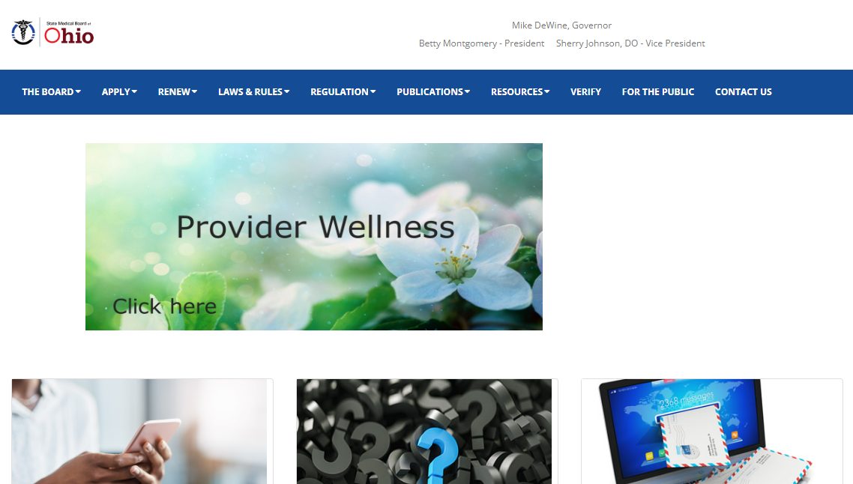
Provider Wellness
New Provider Wellness section on med.ohio.gov. Find resources that address:
Mental health
Addiction recovery
Stress management

Slide 27
Scam Alert Reminder
Reports of spoofing and extortion scams targeting Ohio providers include:
Calls from someone posing as Medical Board staff
Faxes using SMBO letterhead
Claims a provider is being investigated by the FBI or DEA and their license is suspended
Claims a fine is owed immediately
Notes:
If you are contacted by a scammer, please report the incident to your local law enforcement and Ohio's Attorney General by filing a complaint online at ohioprotects.org or by calling 800-282-0515.
If you would https://med.ohio.gov/Regulation/Complaints-and-Investigations like to verify the identity of a State Medical Board of Ohio investigator, we have provided the email addresses of the investigator supervisors at med.ohio.gov/Regulation/Complaints-and-Investigations.

Slide 28
Investigators will not ask for fine payment or personal/sensitive information over the phone and will never contact licensees via fax.
Remember

Slide 29
Questions?

Slide 30
Bruce Saferin, DPM
Supervising Member
State Medical Board of Ohio
30 E .Broad St. 3rd Floor
Columbus, OH 43215
contact@med.ohio.gov
614-466-3934

